Slide 1
GIT - Version Control Systems
Ganesh Palnitkar

Slide 2

Agenda
In this session, you will learn about:
Importance of Version Control System
Importance of Branching and Merging
Branching and Merging Strategies
Learning GIT – Common

Slide 3
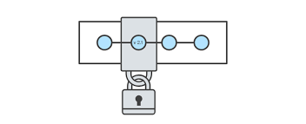
About Version Control Systems
Version control software is an essential part of the every-day of the modern software team's professional practices.
Version control software keeps track of every modification to the code in a special kind of database.
Version control protects source code from both catastrophe and the casual degradation of human error and unintended consequences.
Helps teams to solve problems like, tracking every individual change by each contributor and helping prevent concurrent work from conflict.
Conflicts if any should be solved using help of tool or manually.

Slide 4
Version control systems
Version control (or revision control, or source control) is all about managing multiple versions of documents, programs, web sites, etc.
Almost all “real” projects use some kind of version control
Essential for team projects, but also very useful for individual projects
Some well-known version control systems are CVS, Subversion, Mercurial, and Git
CVS and Subversion use a “central” repository; users “check out” files, work on them, and “check them in”
Mercurial and Git treat all repositories as equal
Distributed systems like Mercurial and Git are newer and are gradually replacing centralized systems like CVS and Subversion

Slide 5
What are Version Control Systems?
Version control software is an essential part of the every-day of the modern software team's professional practices.
Advantages
Version control software keeps track of every modification to the code in a special kind of database.
Version control protects source code from both catastrophe and the casual degradation of human error and unintended consequences.
Helps teams to solve problems like, tracking every individual change by each contributor and helping prevent concurrent work from conflict.
Conflicts if any should be solved using help of tool or manually.

Slide 6
Benefits of Version Control Systems
No need to keep multiple backups.
Allows multiple people to work on same file / project.
A complete long-term change history of every file.
Branching and merging – maintain code as per projects / release / functionality etc.
Traceability - ability to trace each change made to the software and connect it to project management and bug tracking software.
Easily switch / work on earlier file versions.

Slide 7
Git History
Came out of Linux development community
Linus Torvalds, 2005
Initial goals:
Speed
Support for non-linear development (thousands of parallel branches)
Fully distributed
Able to handle large projects like Linux efficiently
Notes:
Initial goals were to support development of Linux

Slide 8

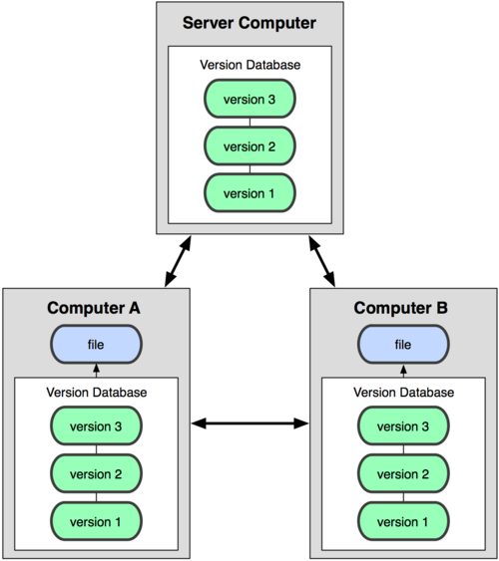
Git uses a distributed model
Centralized Model
Distributed Model
(CVS, Subversion, Perforce)
(Git, Mercurial)
Result: Many operations are local
Notes:
http://git-scm.com/book/en/Getting-Started-About-Version-Control

Slide 9
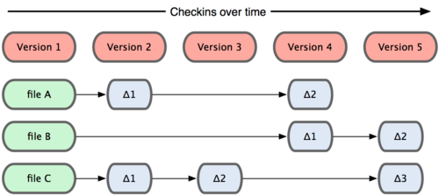
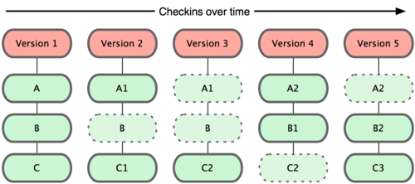
Git takes snapshots
Subversion
Git

Slide 10
Git uses checksums
In Subversion each modification to the central repo incremented the version # of the overall repo.
How will this numbering scheme work when each user has their own copy of the repo, and commits changes to their local copy of the repo before pushing to the central server?????
Instead, Git generates a unique SHA-1 hash – 40 character string of hex digits, for every commit. Refer to commits by this ID rather than a version number. Often we only see the first 7 characters:
1677b2d Edited first line of readme
258efa7 Added line to readme
0e52da7 Initial commit

Slide 11

A Local Git project has three areas
Unmodified/modified Files
Staged Files
Committed Files
Note: working directory sometimes called the “working tree”, staging area sometimes called the “index”.

Slide 12
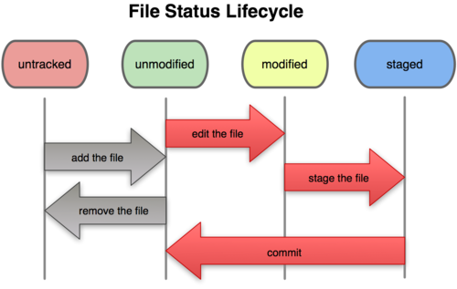
Git file lifecycle

Slide 13
Basic Workflow
Basic Git workflow:
Modify files in your working directory.
Stage files, adding snapshots of them to your staging area.
Do a commit, which takes the files as they are in the staging area and stores that snapshot permanently to your Git directory.
Notes:
If a particular version of a file is in the git directory, it’s considered committed.
If it’s modified but has been added to the staging area, it is staged.
If it was changed since it was checked out but has not been staged, it is modified.

Slide 14
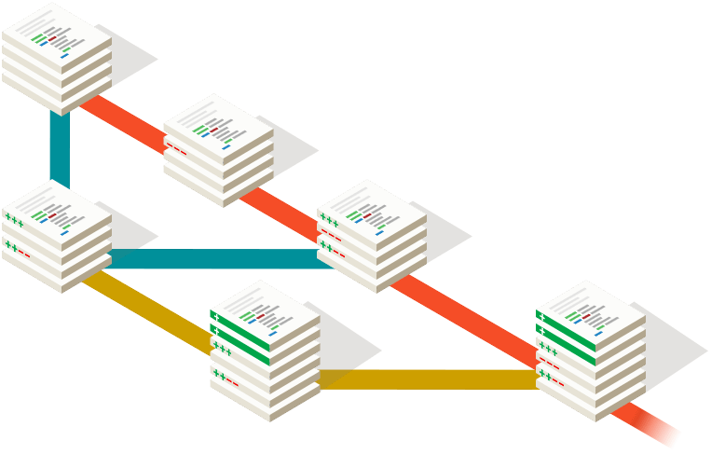
GIT - DVCS
GIT has bash /command-line interface and GUI as well.
Git is a distributed VCS. Provides extremely fast operation.
Does not need centralized server.
Once the entire repository is pulled on local machine, network / internet connection is not required for most of the VCS operations.

Slide 15
Why Git?
Git has many advantages over earlier systems such as CVS and Subversion
More efficient, better workflow, etc.
See the literature for an extensive list of reasons
Of course, there are always those who disagree
Best competitor: Mercurial
I like Mercurial better
Same concepts, slightly simpler to use
In my (very limited) experience, the Eclipse plugin is easier to install and use
Much less popular than Git

Slide 16
Download and install Git
There are online materials that are better than any that I could provide
Here’s the standard one: http://git-scm.com/downloads
Here’s one from StackExchange: http://stackoverflow.com/questions/315911/git-for-beginners-the-definitive-practical-guide#323764
Note: Git is primarily a command-line tool
I prefer GUIs over command-line tools, but…
The GIT GUIs are more trouble than they are worth (YMMV)

Slide 17
Introduce yourself to Git
Enter these lines (with appropriate changes):
git config --global user.name "John Smith"
git config --global user.email jsmith@seas.upenn.edu
You only need to do this once
If you want to use a different name/email address for a particular project, you can change it for just that project
cd to the project directory
Use the above commands, but leave out the --global

Slide 18
GIT - DVCS
Working area: Similar to work area, development environment.
Staging area: Where you store a place a snapshot before committing changes to the local repo.
Local repo: Is a copy of remote repository. This is where you have all versioning of data/code/artifacts maintained.
Remote repository: This can be the GitHub repository or a remote repository maintained on a server on intranet.
GIT works on most of the OS platforms (OSx, Windows, Unix / Linux).
On installation, the GIT config should be run to configure user name, email ID, etc.
In order to start using the VCS, the folder that you want to version control, run the command ‘git init’. This enables the VCS and tracking of file changes in the folder.
GitHub
Remote Repository
fetch
Push
Local Repository
pull
commit
Staging area
add
Working directory
checkout
Download ‘git’ from, http://git-scm.com

Slide 19



Sprint Goal
A short statement of what the work will be focused on during the sprint
Financial Services
Database Application
Support Interfaces rather than streaming real time data.
Make the application run on SAP HANA Server in addition to SQL.
Life Sciences
Support features necessary for critical ailments relation to genes studies.

Slide 20

Distributed VCS & Centralized VCS
push
User A
User B
Local repo
clone
Local repo
pull
commit
commit
Remote repository (GITHUB)
clone
User C
Local repo
DVCS
commit

Slide 21
GIT Common Commands
Below are certain commands that are used often while we use ‘GIT’.
git status
git add
git rm –cached -- to remove file added to staging area
git commit –m “comment”
git log --- use ‘shift+z’ to come out of the log
git diff -- provides info about what has changed in the file
git diff –cached --- diff for the files in the staging area.
git branch -- provides list of all branches
git branch <branch name> -- create a branch
git remote add <name> <url> -- to add remote repo.
git checkout <branch name> -- switch to mentioned branch
git clone <https://remote repo> -- clone from remote repo.
git pull <repo name> <branch name>
Always perform a ‘Pull’ action before ‘pushing’ the code to remote repo.

Slide 22
Git commands
command | description
git clone url [dir] | copy a git repository so you can add to it
git add files | adds file contents to the staging area
git commit | records a snapshot of the staging area
git status | view the status of your files in the working directory and staging area
git diff | shows diff of what is staged and what is modified but unstaged
git help [command] | get help info about a particular command
git pull | fetch from a remote repo and try to merge into the current branch
git push | push your new branches and data to a remote repository
others: init, reset, branch, checkout, merge, log, tag

Slide 23
Create and fill a repository
cd to the project directory you want to use
Type in git init
This creates the repository (a directory named .git)
You seldom (if ever) need to look inside this directory
Type in git add .
The period at the end is part of this command!
Period means “this directory”
This adds all your current files to the repository
Type in git commit –m "Initial commit"
You can use a different commit message, if you like

Slide 24
Clone a repository from elsewhere
git clone URL
git clone URL mypath
These make an exact copy of the repository at the given URL
git clone git://github.com/rest_of_path/file.git
Github is the most popular (free) public repository
All repositories are equal
But you can treat some particular repository (such as one on Github) as the “master” directory
Typically, each team member works in his/her own repository, and “merges” with other repositories as appropriate

Slide 25
The repository
Your top-level working directory contains everything about your project
The working directory probably contains many subdirectories—source code, binaries, documentation, data files, etc.
One of these subdirectories, named .git, is your repository
At any time, you can take a “snapshot” of everything (or selected things) in your project directory, and put it in your repository
This “snapshot” is called a commit object
The commit object contains (1) a set of files, (2) references to the “parents” of the commit object, and (3) a unique “SHA1” name
Commit objects do not require huge amounts of memory
You can work as much as you like in your working directory, but the repository isn’t updated until you commit something

Slide 26
init and the .git repository
When you said git init in your project directory, or when you cloned an existing project, you created a repository
The repository is a subdirectory named .git containing various files
The dot indicates a “hidden” directory
You do not work directly with the contents of that directory; various git commands do that for you
You do need a basic understanding of what is in the repository

Slide 27
Making commits
You do your work in your project directory, as usual
If you create new files and/or folders, they are not tracked by Git unless you ask it to do so
git add newFile1 newFolder1 newFolder2 newFile2
Committing makes a “snapshot” of everything being tracked into your repository
A message telling what you have done is required
git commit –m “Uncrevulated the conundrum bar”
git commit
This version opens an editor for you the enter the message
To finish, save and quit the editor
Format of the commit message
One line containing the complete summary
If more than one line, the second line must be blank

Slide 28
Commits and graphs
A commit is when you tell git that a change (or addition) you have made is ready to be included in the project
When you commit your change to git, it creates a commit object
A commit object represents the complete state of the project, including all the files in the project
The very first commit object has no “parents”
Usually, you take some commit object, make some changes, and create a new commit object; the original commit object is the parent of the new commit object
Hence, most commit objects have a single parent
You can also merge two commit objects to form a new one
The new commit object has two parents
Hence, commit objects form a directed graph
Git is all about using and manipulating this graph

Slide 29
Working with your own repository
A head is a reference to a commit object
The “current head” is called HEAD (all caps)
Usually, you will take HEAD (the current commit object), make some changes to it, and commit the changes, creating a new current commit object
This results in a linear graph: A → B → C → …→ HEAD
You can also take any previous commit object, make changes to it, and commit those changes
This creates a branch in the graph of commit objects
You can merge any previous commit objects
This joins branches in the commit graph

Slide 30
Commit messages
In git, “Commits are cheap.” Do them often.
When you commit, you must provide a one-line message stating what you have done
Terrible message: “Fixed a bunch of things”
Better message: “Corrected the calculation of median scores”
Commit messages can be very helpful, to yourself as well as to your team members
You can’t say much in one line, so commit often

Slide 31
Choose an editor
When you “commit,” git will require you to type in a commit message
For longer commit messages, you will use an editor
The default editor is probably vim
To change the default editor:
git config --global core.editor /path/to/editor
You may also want to turn on colors:
git config --global color.ui auto

Slide 32
Working with others
All repositories are equal, but it is convenient to have one central repository in the cloud
Here’s what you normally do:
Download the current HEAD from the central repository
Make your changes
Commit your changes to your local repository
Check to make sure someone else on your team hasn’t updated the central repository since you got it
Upload your changes to the central repository
If the central repository has changed since you got it:
It is your responsibility to merge your two versions
This is a strong incentive to commit and upload often!
Git can often do this for you, if there aren’t incompatible changes

Slide 33
Typical workflow
git pull remote_repository
Get changes from a remote repository and merge them into your own repository
git status
See what Git thinks is going on
Use this frequently!
Work on your files (remember to add any new ones)
git commit –m “What I did”
git push

Slide 34
Multiple versions
Initial commit
Second commit
Third commit
Bob gets a copy
Fourth commit
Bob’s commit
Merge

Slide 35
Aside: So what is github?
GitHub.com is a site for online storage of Git repositories.
Many open source projects use it, such as the Linux kernel.
You can get free space for open source projects or you can pay for private projects.
Question: Do I have to use github to use Git?
Answer: No!
you can use Git completely locally for your own purposes, or
you or someone else could set up a server to share files, or
you could share a repo with users on the same file system, such as we did for homework 9 (as long everyone has the needed file permissions).

Slide 36
Keeping it simple
If you:
Make sure you are current with the central repository
Make some improvements to your code
Update the central repository before anyone else does
Then you don’t have to worry about resolving conflicts or working with multiple branches
All the complexity in git comes from dealing with these
Therefore:
Make sure you are up-to-date before starting to work
Commit and update the central repository frequently
If you need help: https://help.github.com/

Slide 37
Activity
Run common commands on Git
Understand the output

Slide 38
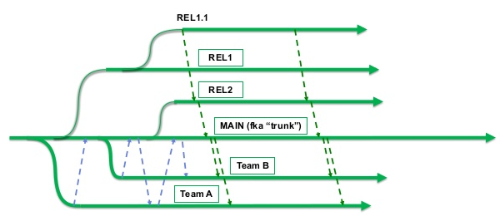
Branching and Merging Strategies
Brach by release, “staircase model”.
Branch by feature. Each distinct branch.
Hotfix branch.
Best practices:
Keep option of branching only if required, keep it simple.
Incase of centralized VCS, merging should be done frequently / sooner (daily recommended)
Use tagging as and when required.
Delete unwanted branches.
Identify shared components in details and in advance.
Merge only when your branch is compliable and stable.
Branching and merging scenario
Master
C0
C1
C2
C4
Common Ancestor
Snapshot to Merge
C3
C5
Feature
Simple Branching and merging in GIT project

Slide 39
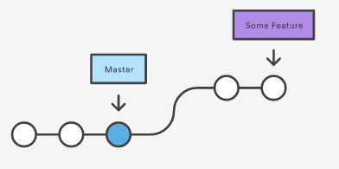
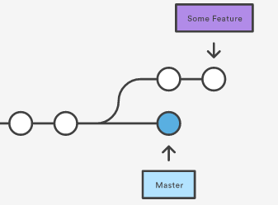
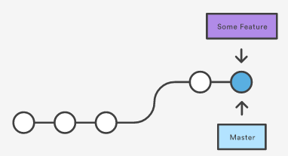
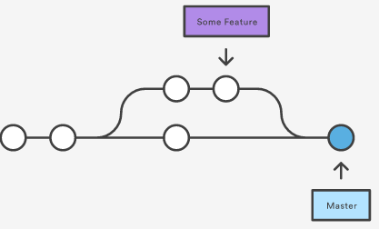
GIT Merge Operations
After Fast-forward Merge
3-way Merge

Slide 40

BitBucket - Definition
Bitbucket is Git repository management solution designed for professional teams.

Slide 41



Key Features of BitBucket
Gives you a central place to manage git repositories
Collaborate on your source code
Guide you through the development flow
Notes:
It gives you a central place to manage git repositories
Collaborate on your source code and
Guide you through the development flow

Slide 42
Features of Bitbucket
Access control to restrict access to your source code.
Workflow control to enforce a project or team workflow.
Pull requests with in-line commenting for collaboration on code review.
Jira integration for full development traceability.
Full Rest API to build features custom to your workflow if they are not already available from our Marketplace

Slide 43
Bitbucket Cloud
Bitbucket Server
Bitbucket Cloud and Bitbucket Server
Hosted on Atlassian's servers and accessed via a URL.
Bitbucket Cloud has an exclusive built-in continuous integration tool, Pipelines, that enables you to build, test and deploy from directly within Bitbucket.
Hosted on-premise, in your environment.
Bitbucket Server does not come with a built-in testing and deployment tool, but it has strong integrations with CI / CD tool like Bamboo.

Slide 44
Activity
Demo of Bit Bucket – Common Operations

Slide 45
Questions for you
What is the difference between pull and a check out?
Who originally wrote git and why?
What process should be done before each check-in?
What types of file should NOT be included in source control?

Slide 46
Git Resources
At the command line: (where verb = config, add, commit, etc.)
$ git help <verb>
$ git <verb> --help
$ man git-<verb>
Free on-line book: http://git-scm.com/book
Git tutorial: http://schacon.github.com/git/gittutorial.html
Reference page for Git: http://gitref.org/index.html
Git website: http://git-scm.com/
Git for Computer Scientists (http://eagain.net/articles/git-for-computer-scientists/)

Slide 47
Thank you!

